Slide 1
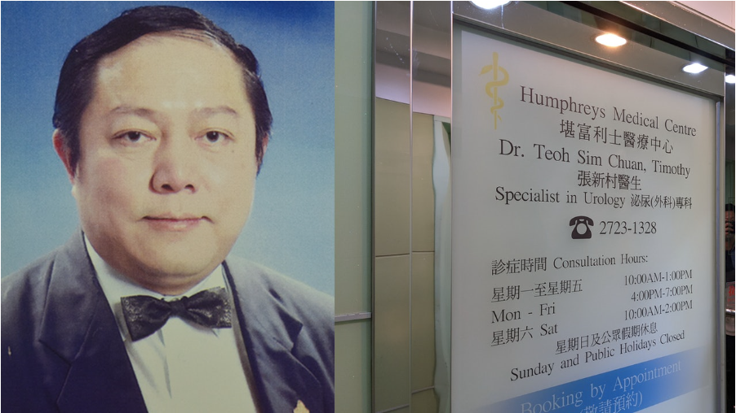
APSS1L01 Group 9
Dr. Teon Sim Chuan (Zhang Xincun), a celebrated urologist, mistakenly removed the patient's spleen instead of her kidney in 2019.
He recorded the phrase “During the operation revealed that he failed to correctly identify the two organs” into the operation record.
He even persuaded his patient to undergo the operation again when her patient got a fever, and even tried to rationalize the removal of the spleen and tamper with medical records.
Case Analysis:
He tried to conceal his fault and made it reasonable, which violates the moral principle and the universal ethical principles, such as integrity, respect for others, and kindness.
He shouldn’t try to amend the mistake that injured another's health, instead of concealing it with another deceit, just for showing his profession to the public.
He should, in fact, admit his fault and apologize to his patient formally to show his profession and high standard of morality.
Sources taken from https://newsrnd.com/news/2022-06-20-zhang-xincun--a-famous-urologist--was-suspended-for-18-months-for-six-crimes-of-professional-misconduct.Hy3MLCat9.html
First morality news:
Removal of Patient’s Spleen Mistakenly

Slide 2
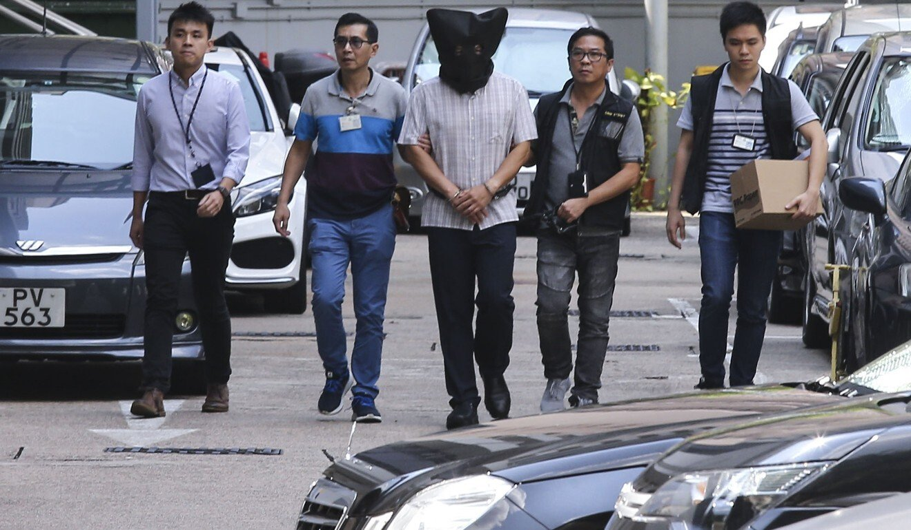
Second Morality news:
Yoga ball murder: CUHK professor murdered his wife and daughter
Khaw Kim Sun, a professor at CUHK killed his wife and daughter with a carbon monoxide-filled yoga ball in 2015. Mr. Khaw filled two balls with carbon monoxide. He tried to pretend that he was going to kill animals with the gas. And he used those balls to kill his wife and daughter with carbon monoxide poisoning. After two years in 2018, Khaw Kim Sum was convicted by Hong Kong Court and sentenced to life imprisonment.
Case Analysis
Sources taken from https://www.scmp.com/news/hong-kong/law-and-crime/article/3092059/yoga-ball-murder-malaysian-professor-hong-kong-who
Mr. Khaw’s action is illegal as he murdered his wife and daughter with a carbon monoxide-filled yoga ball and he should be put into jail.
In order to conceal his fault, he tried to pretend that he was going to kill animals with the gas. But it is not reasonable. He just wants to avoid punishment by law. We can see that Mr. Khaw is at stage 1(Punishment orientation) of Kohlberg’s stage of moral development.

